Slide 1
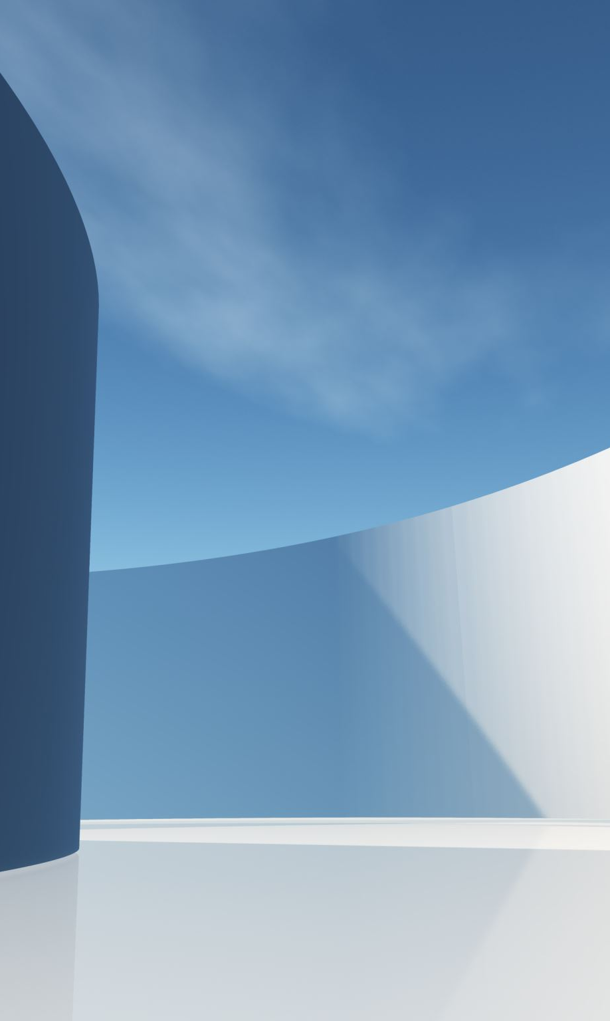
Cardiopulmonary Interactions
Lasse Leuchtmann

Slide 2
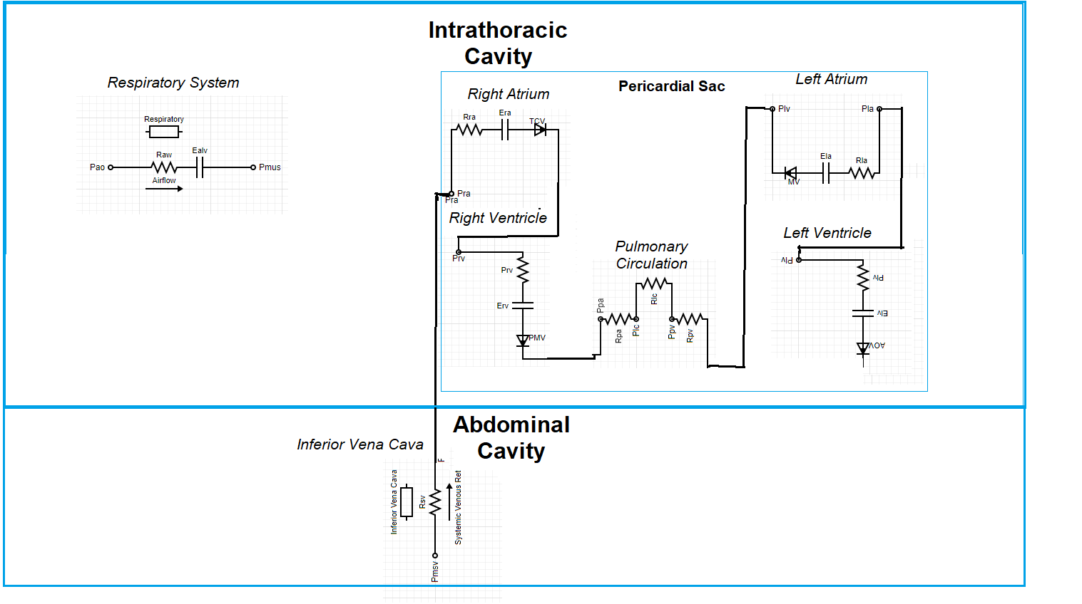
CardioPulmonary System

